Slide 1
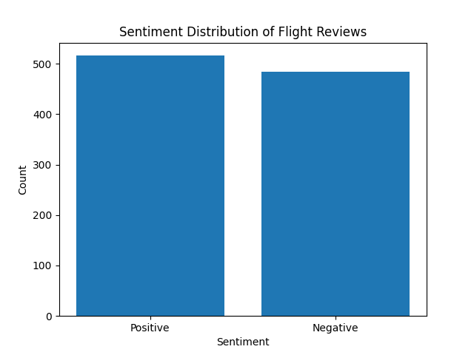
Sentiment Distribution of Flight Reviews for British Airways
The objective of the analysis was to understand the sentiment expressed in customer reviews for British Airways flights.
The sentiment analysis was performed using a technique called SentimentIntensityAnalyzer, which assigned a sentiment score to each review.
Reviews were classified as "Positive" if the sentiment score was above zero, and "Negative" if the score was below zero.
The sentiment analysis revealed insights into the overall sentiment of the reviews, allowing us to gauge customer satisfaction levels.
These findings can help British Airways identify areas of strength and areas that may require improvement, enabling them to enhance the overall customer experience.

